Slide 1
League Apps
FOR MANAGERS
How to work inside League Apps / Tutorial

Slide 2
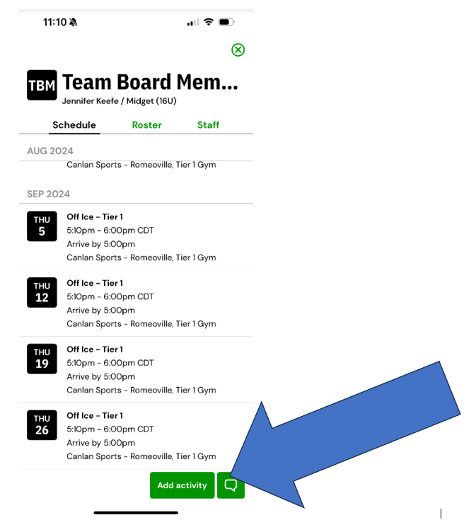
Adding Events / Games / Tournaments
After you have clicked on your TEAM in the Teams tab – you can access adding an activity on the schedule.
Simply click “Add activity” at the bottom of the screen
Once you click add activity – you will begin filling in the data for the event.

Slide 3
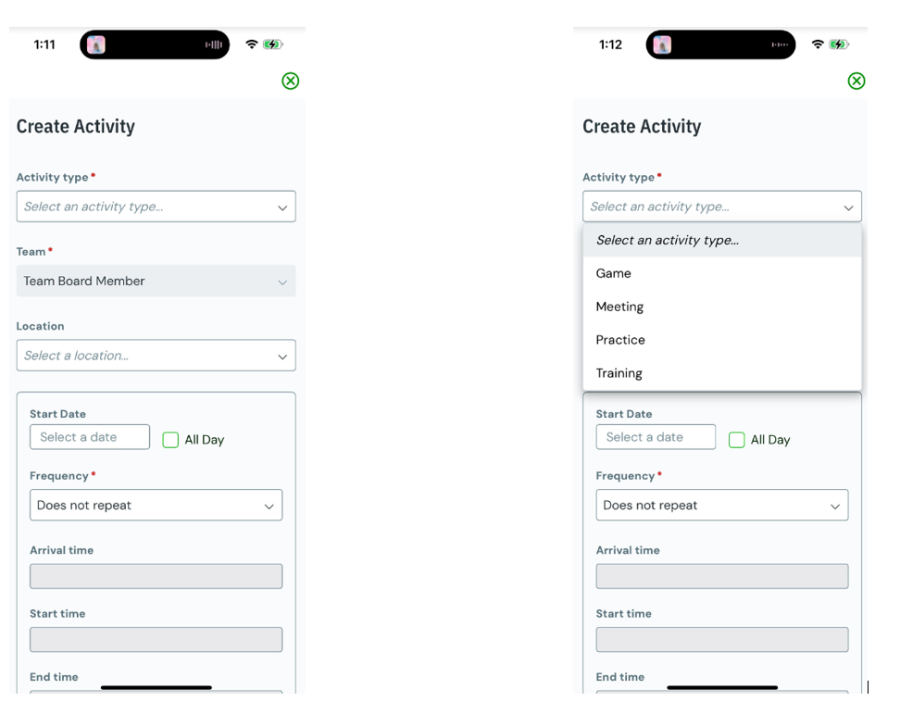
Adding Events / Games / Tournaments
After clicking ADD ACTIVITY you will land on pic 1
Here is where you will input all the details of your event
First drop down is the activity type (pic 2)
You can customize each event according to the bucket they fall into. Meeting can be used for parent meetings & training can be utilized for off ice and video review

Slide 4
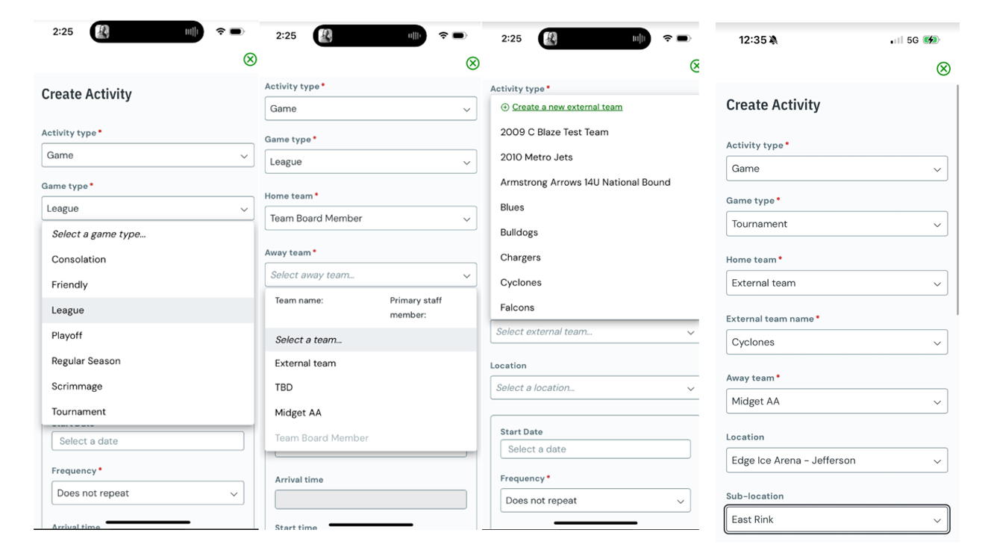
Adding Events / Games / Tournaments
When adding a Game or Tournament, you will select both the following:
  Activity Type
  Game Type
  Who the home team is – see note below
  opposing team
  Location – detailed on next slide
Depending on where your game is, the home team can be “EXTERNAL TEAM “ This will allow a second drop down to appear to add the team you will be visiting as “home” and your team as “away

Slide 5
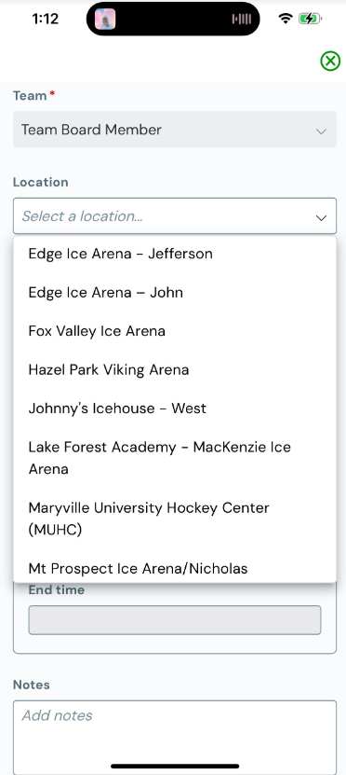
Adding Events / Games / Tournaments
Once you choose and enter your activity type, the next drop down is LOCATION
Once you open the location drop down, you can scroll to find your location.
Currently we are inputting all locations on the back end of the app. This means David Altholz or Jen Keefe need to input locations. If you cannot find a location, please reach out.– Note you will need to provide tournament locations prior to inputting the games into the app at this time.
There is a pending app update which will allow you to enter locations yourself. Once this update is available, we will send out a note to all Coaches and Managers.

Slide 6
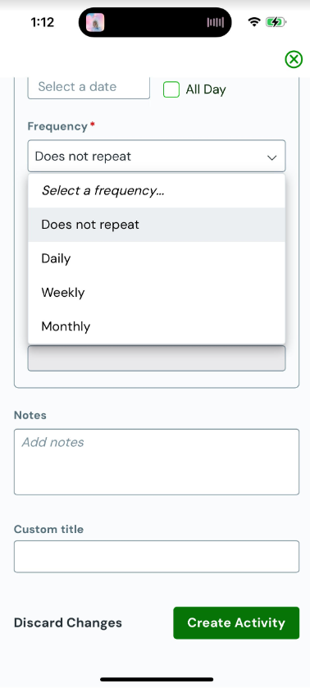
Adding Events / Games / Tournaments
After adding your location, you need to update the frequency.
This tool is most beneficial for adding practices, off ice, and video review in bulk.
To avoid having to enter repeating events multiple times, you can enter weekly to have Tuesday Practices, off ice/video review, and Thursday Practices all at once.
If a date in the occurrence isn’t needed – you can go back and delete the entry for the specific date needing removal. This way you can save time entering reoccurring items vs. adding them one at a time. This is very similar to how Team Snap works.

Slide 7
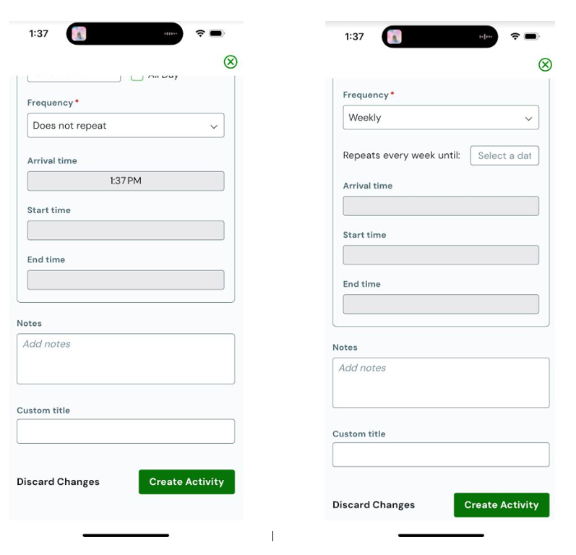
Adding Events / Games / Tournaments
If you choose DOES NOT REPEAT you will move on to the arrival time, start time, and end time input fields (pic 1)
Arrival time should be the standard for your team – please double check with your coaches on how early players should arrive for practice, games, and events.
If you are inputting a repeating event, you will choose your frequency (weekly will be most used) and select an END DATE for the occurrence. Then you will go on to add arrival, start, and end times.
Notes section can be used to remind players of colors, shoes for off ice, etc.
CUSTOM TITLE – this is where you will type the name of your event. You must add a custom title for your push notifications and emails to make sense.
Examples:
  GAME VS Jaguars – 7pm CST
  Off Ice – Tier 1
  Video Review
  Tournament Team Dinner

Slide 8
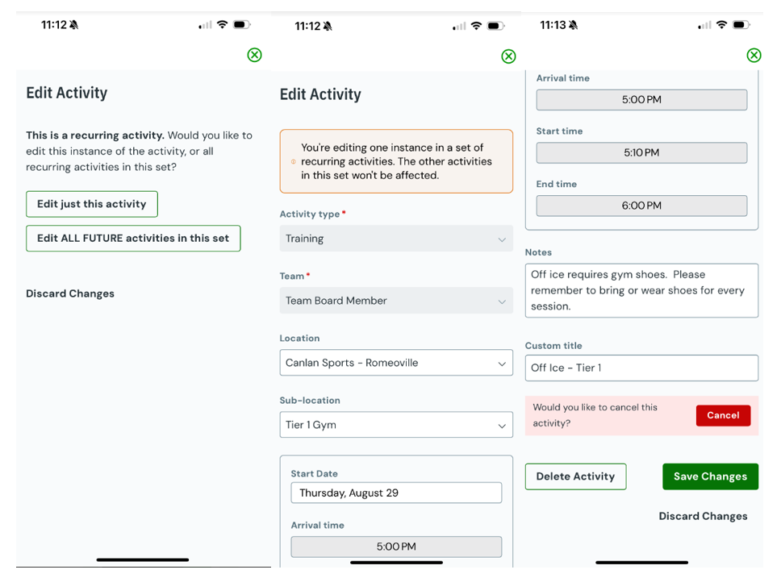
Adding Events / Games / Tournaments
To EDIT a reoccurring activity simply click into the activity from your home screen or calendar toggles and press EDIT (located in top right corner of screen)
When editing, the app will ask if you want to edit the specific date you clicked on
  Edit Just This Activity
Or it will ask if you want to Edit ALL FUTURE activities in this set. Meaning, it will edit all reoccurring events occurring after the date you have selected
  Edit ALL FUTURE activities in this set - you would use this for a permeant off ice or video review time change, or possibly a practice time change. However, this would be unlikely, and you are mostly going to use the “Edit just this activity” feature
You will have the choice to DELETE a single date. The second picture is where you can either edit the details or DELETE a singular event. You would scroll to the bottom to select delete. If you need to change the time, you can do so here.
You can easily Cancel or Delete any activities occurring during non hockey weeks – such as Christmas Break. (pic 3) …………….

Slide 9
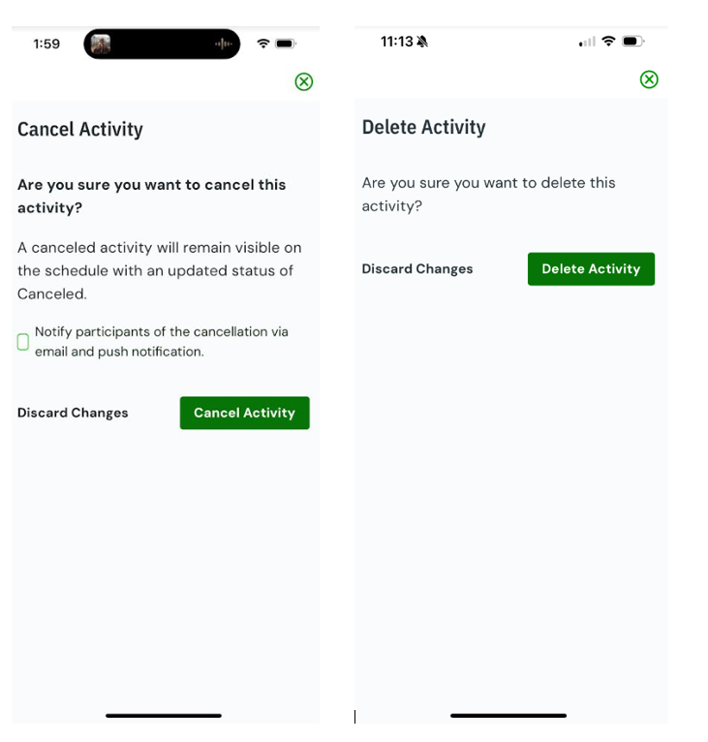
Cancelling or Deleting –
Events / Games / Tournaments
CANCEL vs. DELETE
You can cancel an event – and allow it to still show in the calendar as CANCELLED
  I recommend choosing CANCEL to notify parents of schedule changes– this way parents know it was cancelled when looking at their calendars, as the event will still show – but show as CANCELLED.
  During a cancellation you have the choice to NOTIFY the team via email and push notification. I HIGHLY Recommend using this feature when cancelling something parents were planning on attending.
If you DELETE – this will completely remove the event from the calendar.
  I recommend deleting reoccurring events on the dates the event is NOT needed. Utilizing this feature for reoccurring practices, off ice, and video review which need to be removed as if they never existed.

Slide 10
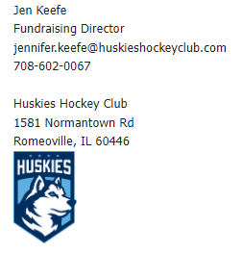

Need Help? Contact either of the below for assistance anytime!

